Slide 1

CUSTOMER CHURN PREDICTION
PORTFOLIO PROJECT ON CLASSIFICATION
APOORVA KALASKAR (DP-2008-OM)

Slide 2

PROBLEM STATEMENT
Happy customers is a priority for growth of any business. Same way it is important for telecom industry to keep a track on customer retention.
Customer retention is easier than acquiring new customers as you have already gained loyalty from them.
Customer churn can have multiple reasons and it impedes the growth of the companies.
Organizations need to have specific algorithm to calculate the customer churn rate and factors impacting it for business wellness.

Slide 3
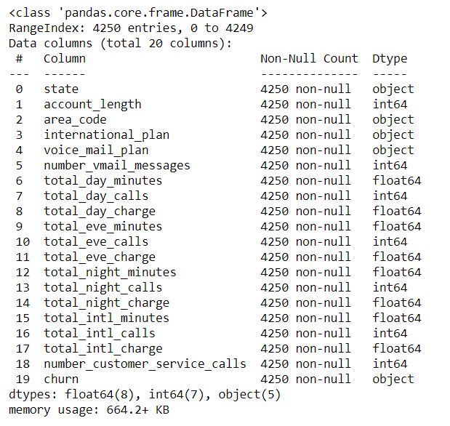
DATASET
Dataset for customer churn was downloaded from internet.
The dataset has 20 attributes in total across 4250 records.
The response variable is ‘churn’ which gives us a categorical output of customer churn.
The predictors include customer stay tenure, plan details and call details at different time of day.

Slide 4
DATA PREPROCESSING AND MODEL BUILD
Data description and Variable Identification
Univariate Analysis and Visualization
Outlier Detection and Treatment
Bivariate Analysis
Data Transformation
Model Build (Logistic Regression/Random Forest)
Model Validation and Accuracy
Creation of Pickle File

Slide 5
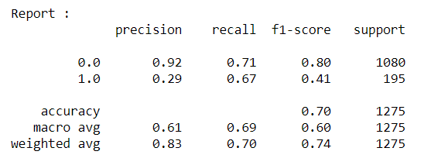
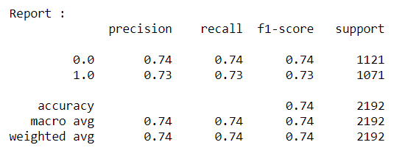
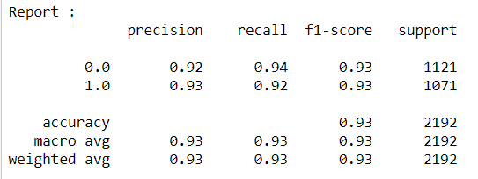
MODEL BUILD AND RESULTS
Logistic Regression
1. All Features -> Accuracy 75.39%
Classification report:
2. SMOTE Dataset -> Accuracy 80.30%
Classification report:
Random Forest
A. All Features -> Accuracy 83.97%
B. Feature Selection -> 97.70%
C. Hyper Parameter Tuning -> 92.74%

Slide 6
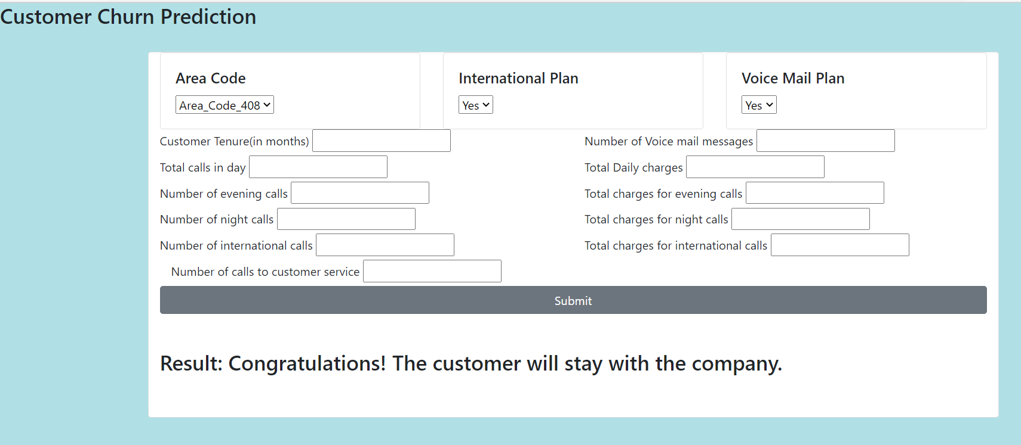
CUSTOMER CHURN PREDICTION GUI

Slide 7
THANK YOU!

